Slide 1
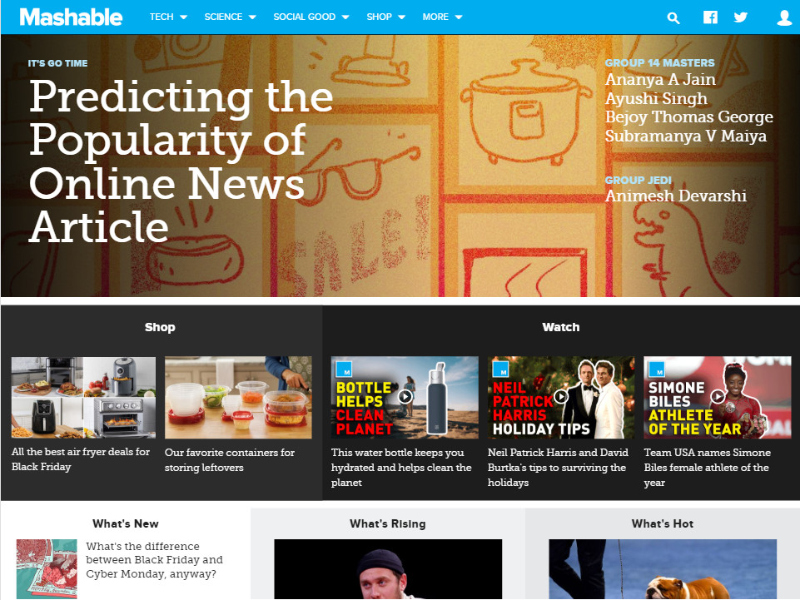
SUBMITTED BY :
AYUSHI SINGH
PROJECT : ONLINE NEWS POPULARITY

Slide 2
Introduction
Most of peoples now have the habit of reading and sharing news online. With the help of Internet, the online news can be instantly spread around the world.
An early example of an "online only" newspaper or magazine was (PLATO) News Report, an online newspaper created by Bruce Parrello in 1974.
By the late 1990s, hundreds of U.S. newspapers were publishing online versions, but did not yet offer much interactivity
Younger people from 25- to 34-year-olds are more willing to pay for digital news than older people across all countries.
Mashable is a media based company which publishes blogs and articles in different fields or data channel. It was launched by Pete Cashmore in 2005, it was a lifestyle blog originally for the digital generation.

Slide 3
Problem statement
In this project, we will use machine learning techniques to predict the popularity of an online article based on its number of shares and content.
It is important because the revenue generated for the media based companies is dependent on receives.
Industry Impact:
With increase in media based companies, the competition has also gradually increased. So the companies need to focus on the content and other features of articles and understand what the user is expecting.
The popularity of an article is expressed by its number of, which dictate its outreach and exposure. With a fast moving world looking for easy media consumption and instant gratification, staying on top of the latest news, while being relevant is crucial.
Notes:
The categorical features are :
data_channel_is_lifestyle
data_channel_is_entertainment
data_channel_is_bus
data_channel_is_socmed
data_channel_is_tech
data_channel_is_world
weekday_is_Monday weekday_is_Tuesday weekday_is_wednesday weekday_is_thursday weekday_is_friday weekday_is_saturday weekday_is_sunday is_weekend These columns are already label encoded. So we don’t need to use label encoding or dummies.
14. data_channel_is_lifestyle: Is data channel 'Lifestyle'?
15. data_channel_is_entertainment: Is data channel 'Entertainment'?
16. data_channel_is_bus: Is data channel 'Business'?
17. data_channel_is_socmed: Is data channel 'Social Media'?
18. data_channel_is_tech: Is data channel 'Tech'?
19. data_channel_is_world: Is data channel 'World’?
Keywords – Likes and Comments
NLP – LDA & Pos & Neg polarity of words

Slide 4
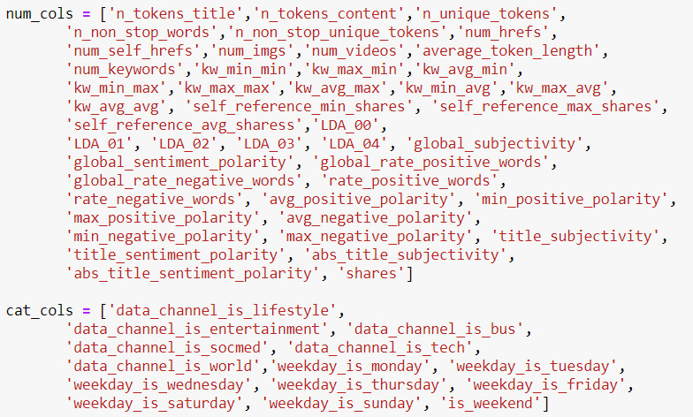
Data Description
This dataset contains set of features about articles published by Mashable in a period of two years(2013-2014).
The dataset contains 39644 number of records and 61 attributes (58 predictive attributes, 2 non-predictive (URL & Time Delta) and a target variable). 30 attributes were created as a result of NLP performed on the articles.
The goal is to predict the number of shares in social networks (popularity).

Slide 5
Data Cleaning
No missing values is present in the dataset.
A new feature called ‘popularity’ is created and the articles which are having shares greater than 1400(median) are considered as Popular and others as Non-Popular.
Further probing the data, we found 1160 rows that indicated articles with 0 words in the content. These rows were dropped.
Another abnormality noticed was that, the rate of unique words in the content was scored between 0 to 1. But 1 row had a score of 701. This anomaly too was dropped.
For EDA we extracted the months the article were published from the URL.
Label encoding was not required since all categorical columns were already dummy encoded.

Slide 6
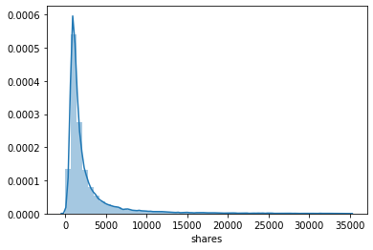
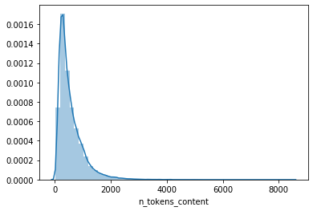
Exploratory Data Analysis
Univariate Analysis
Shares Distribution
Number of words in the content

Slide 7
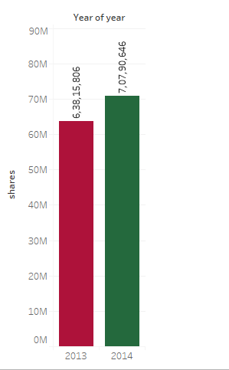
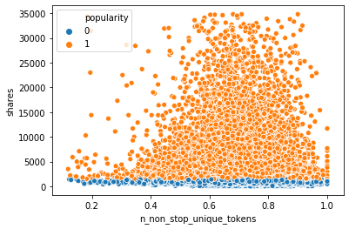
Bivariate Analysis
Shares Distribution
Versus Year
Number of non-stop unique words in the content Versus Shares

Slide 8
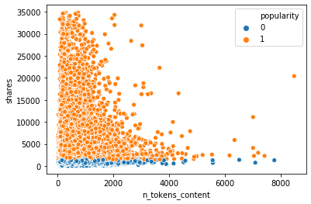
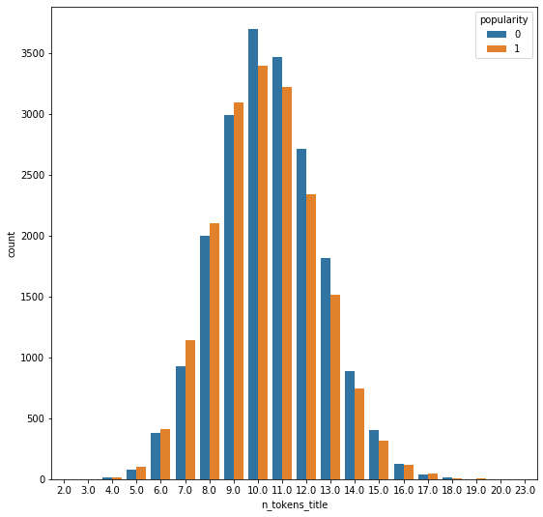
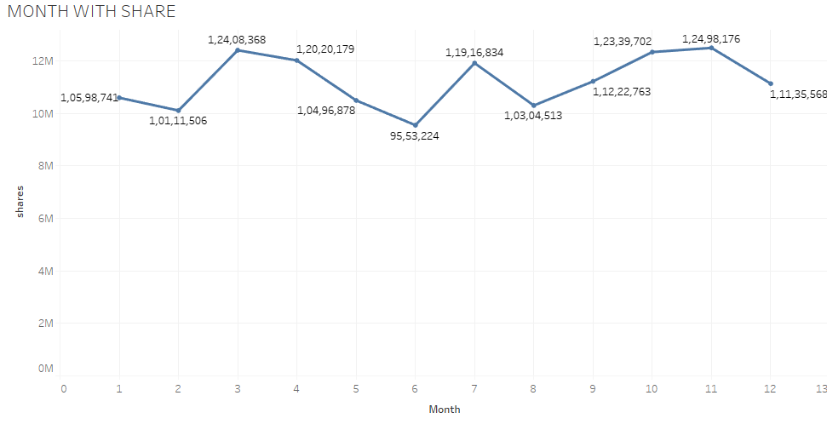
Number of words in Content Versus Shares
Number of Words in Title
Versus Shares
Month
Versus Shares

Slide 9
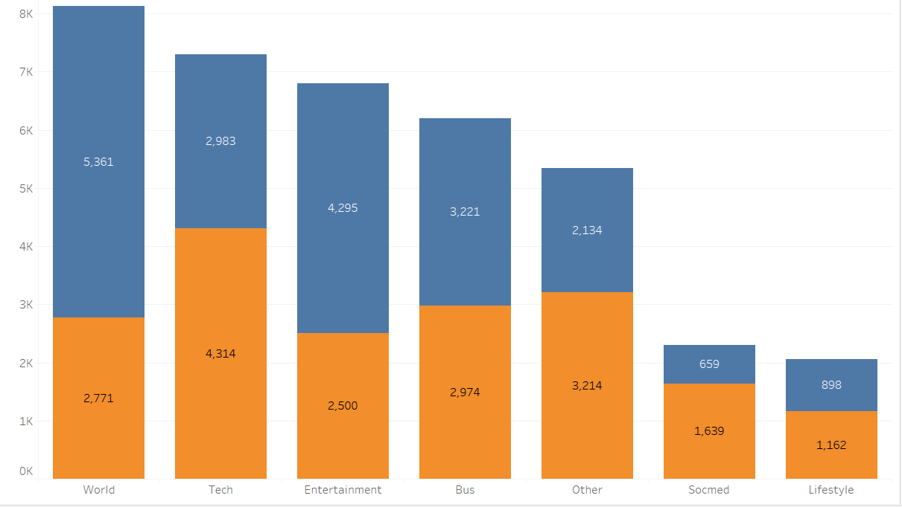

Data Channel Versus Popularity
BUS | 48%
ENTERTAINMENT | 36%
LIFESTYLE | 56%
OTHER | 60%
SOCIAL MEDIA | 71%
TECHNOLOGY | 59%
WORLD | 34%

Slide 10
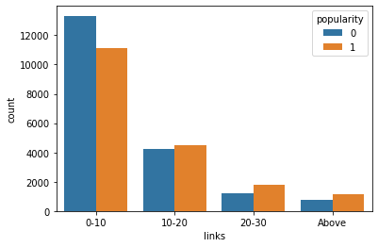
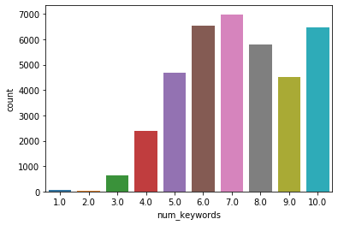
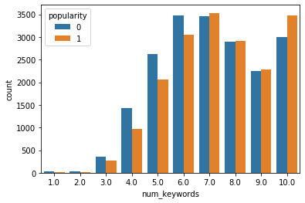
Number of self referenced links
Versus Shares
Number of Keywords Versus Shares

Slide 11
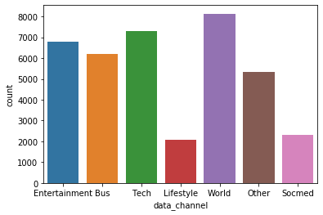
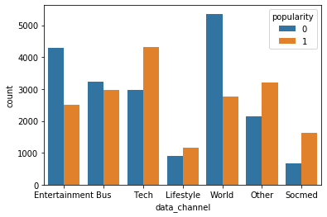
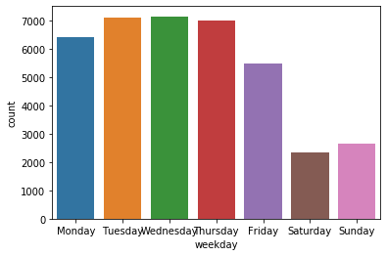
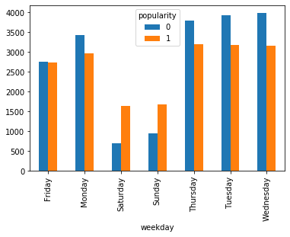
Popularity of Articles on different days of the week and across different channels

Slide 12
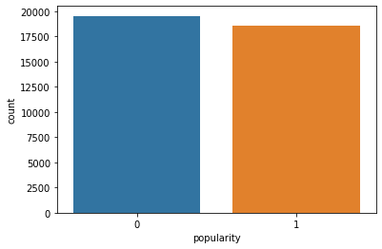
Class Distribution of a Target Variable
Since the count of articles which are popular and non-popular are almost same we can say that the dataset is balanced.
51.28%
48.72%

Slide 13
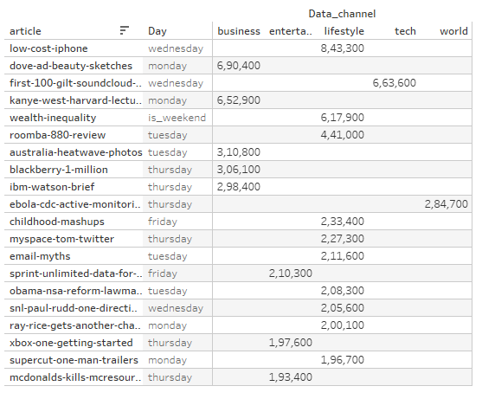
Top 20 Articles with number of shares

Slide 14
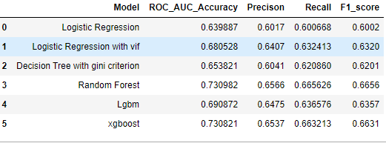
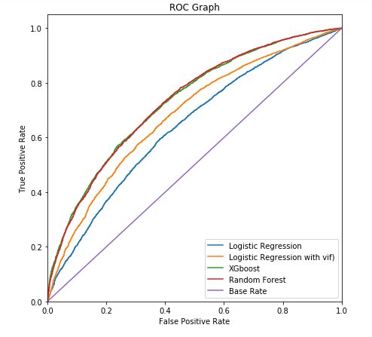
Classification models
When comparing results, we got from LR, LR with VIF, RF, XGboost the highest accuracy
achieved was from random forest using randomizedSearchCV with an accuracy of 73.1%.
Using VIF feature selection method accuracy increased for Logistic Regression.
XGBoost gave the roc accuracy near to random forest but the precision and recall scores
are more for RF. As a result, we consider random forest to be the best model for
predicting online shares to an article.

Slide 15
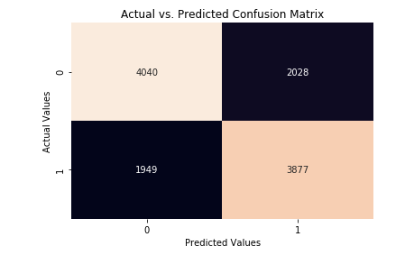
Confusion Matrix
True positives: 3877 (Articles which were popular and were predicted as popular)
True Negative: 4040 (Articles which were predicted as not popular and were actually popular)
False Positive: 2028 (Articles which were predicted as popular but were not popular)
False Negative: 1949 (Articles which were predicted as not popular but were actually popular.
Precision=TP/ (TP+FP) =3877/ (3877+2028) =0.6566
Recall=TP/ (TP+FN) =3877/ (3877+1949) =0.6654

Slide 16
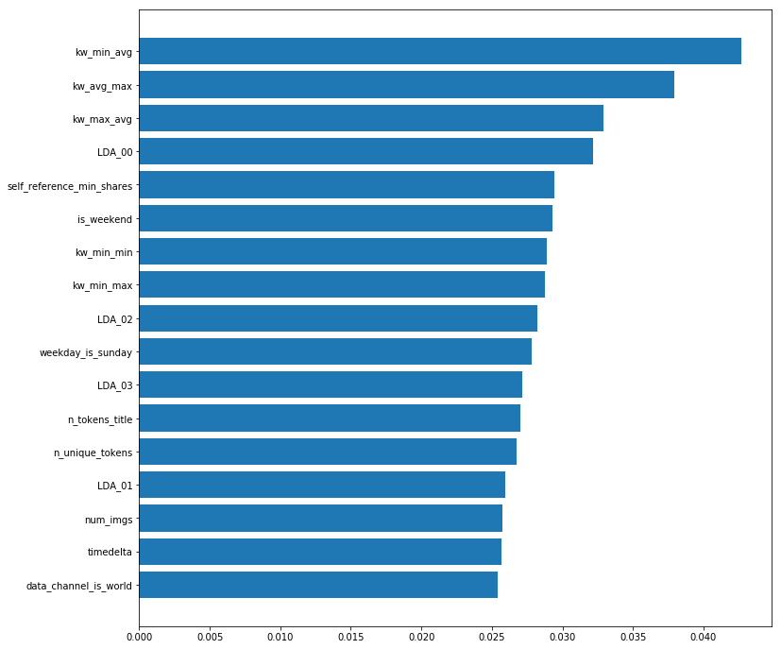
Feature Importance using random forest

Slide 17
Statistical Test on Important Features from Random Forest
Attribute | pval | 0 (not popular) | 1(popular)
kw_avg_min | 9.7121e-75 | 288.903 | 336.453
self_reference_avg_sharess | 1.7029e-211 | 4890.604 | 7952.958
self_reference_min_shares | 3.3586e-201 | 2991.107 | 5033.188
kw_max_avg | 3.1187e-278 | 5207.127 | 6119.258
kw_avg_avg | 0.0 | 2925.0296 | 3352.291
After checking the p-value, which is less than 0.05, for 95% confidence interval, we fail to accept the null hypothesis. Thus, there exists significant difference between the mean of all these groups.

Slide 18
Limitations
As one of the features of the dataset is URL on which text mining can be performed which would improve the accuracy. But as we don’t have knowledge of text mining, we couldn’t use that.
According to our dataset we needed more features relevant to shares prediction which would contribute to accuracy of the classification models.
The dependent and the independent features had no linear relationship so it was hard to come to proper inferences.
LDA_00, LDA_01, LDA_02, LDA_03, LDA_04 are topical modelling features from NLP that are undefined. Since we do not know the topics, we could not infer from them.

Slide 19
Recommendations and Actionable Insights
The no of keywords in the article should be a range between 6 to 10. Keyboards lesser than 6 leads to less discovery and hence less shares, while keywords more than 10 implies more words in the articles or an article of varied topics. These negatively affect the number of shares.
The timing of publishing in relation to the content affects its popularity.
The number of words in the article should be less than 1500 words. The lesser the better.
Article title shouldn’t be too long or too short. 6 – 14 words is the ideal number of words to have for titles.
Articles should have good amount of images. Between 1 – 20 images is great. Also having a couple of videos is also nice for article popularity, but not too much. The higher the lower the odds.
The number of keywords in the metadata really influences the shares to a margin. The higher the value the better the shares chances. A value upward of 5 is recommend.
The number of words in the tile should be in the range 8 to 13. More or less negatively impacts the number of shares.

Slide 20
Articles referencing popular articles have a higher chance of improving their own popularity.
Increase the number of popular unique words in the article to increase the chances of having better popularity.
The amount of multi-topic discussion in an article must be reduced. It would be recommended that different domains be created to cater to different topics.
Best popular articles are usually posted on Mondays and Wednesday (and a bit of Tuesdays). Sundays and Saturdays (Weekends generally) are the worsts days to publish an article.
Articles that talks about current trending tends to have higher popularity. Ideally, articles about a company/product published before their earnings call generate more shares.
Increase the amount of subjectivity in the title and content.
The "Social Media" and "Others" channel are great for the best popularity. Though the number of articles are more in "World" channel, it does not contribute to more popularity.

Slide 21
Conclusion
While working on visualising the features we found that the there were not much correlation between the dependent and independent feature but when each column were checked against shares, we got some insights like when the title had either less nor more number of words in the title, that particular article got more number of shares. Another observation was when the words in title were in the range 6-15 the articles were popular.
On applying various classification models along with different feature selection, we found that random forest got the best ROC Score out of all the models with a ROC Score of 73.1%. As the data was balanced so we didn’t use any sampling technique. Outliers were retained since removing them didn’t impact model scores significantly.
For our model we are considering recall rather than precision as we want to focus on articles where the number of shares were more. Thus, focusing on the articles which predicted as popular and were actually popular. So accordingly, we will focus on those articles to see what are the factors which will increase the popularity of the articles.

Slide 22
THANK YOU!

